Slide 1
Direct Memory Access (DMA)
(Lecture 49-50)

Slide 2
Modes of Data Transfer
The transfer can be made in several ways that are:
DMA Burst :- In DMA Burst transfer, a block sequence consisting of a number of memory words is transferred in continuous burst while the DMA controller is master of the memory buses. Used for fast devices such as magnetic disks, where data transmission cannot be stopped or slowed down until an entire block is transferred.
Cycle Stealing :- Cycle stealing allows the DMA controller to transfer one data word at a time, after which it must returns control of the buses to the CPU. CPU is usually much faster than I/O (DMA), thus CPU uses the most of the memory cycles. DMA Controller steals the memory cycles from CPU and CPU remains idle. For slow CPU, DMA Controller may steal most of the memory cycles which may cause CPU remain idle long time.
Interleaving Mode: Whenever CPU does not require the system bus then only control of buses will be given to DMAC. This is slowest mode of data transfer.

Slide 3
DMA Controller (DMAC)
The DMA controller communicates with the CPU through the data bus and control lines as shown in figure on next slide. DMA select signal is used for selecting the controller, the register select is for selecting the register.
● When the BG (Bus Grant) = 0, the CPU can communicate through the data bus to read or write into the DMA register.
● When BG = 1, the DMA controller takes the control of buses and transfers the data between the memory and I/O.
● The DMA controller has three registers.
● The address register specifies the desired location of the memory which is incremented after each word is transferred to the memory.
● The word count register holds the number of words to be transferred which is decremented after each transfer until it is zero. When it is zero, it indicates the end of transfer. After which the bus grant signal from CPU is made low (BG=0) and CPU returns to its normal operation.
● The control register specifies the mode of transfer which is Read or Write.

Slide 4
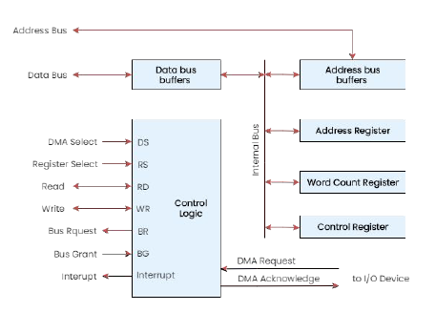
DMA Controller – Block Diagram
Fig: Block diagram of a DMA Controller

Slide 5
DMA Transfer in Computer System
Connection between DMAC and other components of computer (Memory and peripheral devices) is shown in next slide.
Following are the steps for DMA transfer:
I/O Device sends a DMA request.
DMA Controller activates the BR line.
CPU responds with BG line.
DMA puts the current value of its address register into the address bus, initiates the RD or WR signal, and sends a DMA acknowledge to the I/O device.
I/O device puts a word in the data bus (for write) or receives a word from the data bus (for read).
The peripheral unit can then communicate with memory through the data bus for direct transfer between the two units while the CPU is momentarily disabled.
For each word that is transferred, the DMA increments its address register and decrements its word count register. If the word count does not reach zero, the DMA checks the request line coming from the I/O Device.
If there is no request ,the DMA disables BR so that the CPU continues to execute its own program.
When I/O requests another transfer, DMA requests bus again.
If the word count register reaches zero, the DMA stops any further transfer and removes its bus request. It also informs the CPU of the termination by an interrupt.

Slide 6
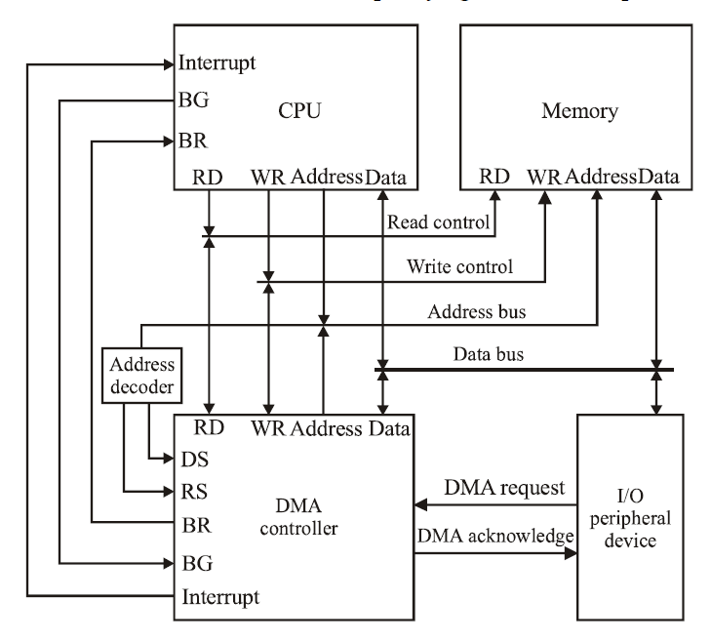
DMA Transfer in Computer System
Fig: Connection between DMAC and other components of computer

Slide 7
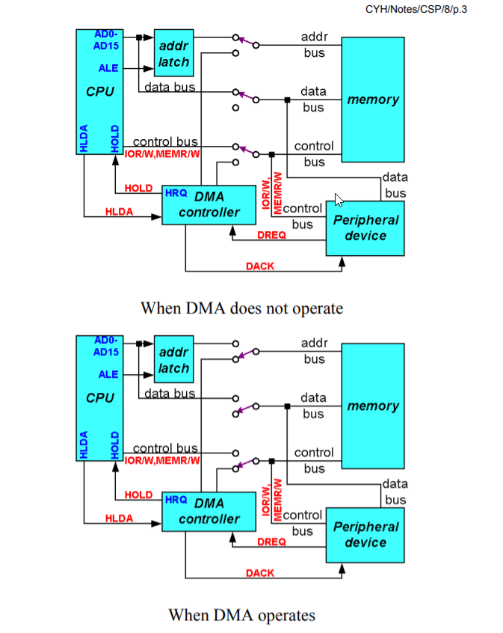
How does data transfer work in direct memory access?

Slide 8
Advantages and Disadvantages
Advantages of DMA Controller
Data Memory Access speeds up memory operations and data transfer.
CPU is not involved while transferring data.
DMA requires very few clock cycles while transferring data.
DMA supports large data transfer.
DMA helps the CPU in decreasing its load.
Disadvantages of DMA Controller
Direct Memory Access is a costly operation because of additional operations.
DMA functionality may not be universally supported across all hardware platforms or peripherals.
DMA Controller increases resource conflicts and security risks.
DMA Controller increases the complexity of the software.

Slide 9
Intel 8257 DMA Controller
Features of Intel 8257:-
The chip is supplied in 40-pin DIP (Dual Inline Package).
It has four channels (CH0-CH3) which can be used over four I/O devices.
Each channel has 16-bit address and 14-bit counter.
Each channel can transfer data up to 64kb or 2^16.
Each channel can be programmed independently.
Each channel can perform read transfer, write transfer and verify transfer operations.
It generates MARK signal to the peripheral device that 128 bytes have been transferred.
Its frequency ranges from 250Hz to 3MHz.
It operates in 2 modes, i.e., Master mode and Slave mode.

Slide 10
Master Vs Slave Mode - 8257 DMA Controller
In DMA 8257, the master and slave modes refer to different operational modes of the DMA controller:
Master Mode: In master mode, the DMA controller 8257 acts as the master controller, managing and initiating data transfers between memory and peripheral devices independently of the CPU. It can handle multiple peripheral devices and prioritize data transfers based on preconfigured settings.
Slave Mode: In slave mode, the DMA controller 8257 acts as a slave device controlled by the CPU. In this mode, the CPU manages and initiates data transfers by issuing commands to the DMA controller. The DMA controller executes the data transfer operations as instructed by the CPU, typically under direct program control. This mode is useful when the CPU needs to have more precise control over data transfers or when specific timing or synchronization is required.
Master mode is often used in systems where high-speed, autonomous data transfers are required to offload the CPU, while slave mode is used when the CPU needs to manage and coordinate data transfers more directly.

Slide 11
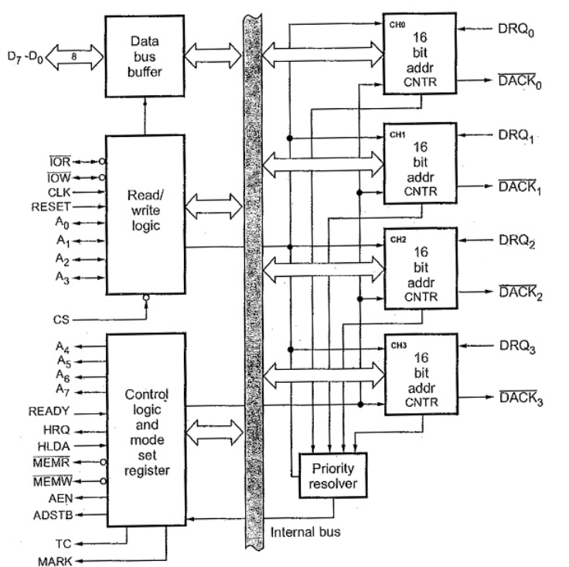
Intel 8257 – Block Diagram
Fig: Intel 8257 – Block Diagram

Slide 12
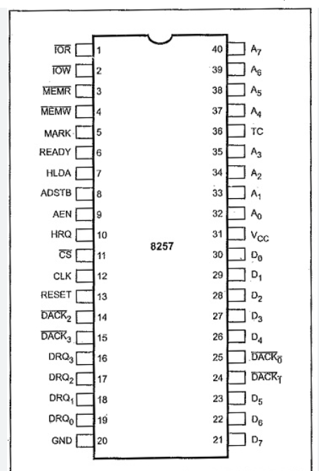
Intel 8257 – Pin Diagram
Fig: Intel 8257 – Pin Diagram

Slide 13
Intel 8257 – Pin Description
DB0-DB7 (Data Bus): These are the bidirectional data lines used for transferring data between the DMA controller and the system bus.
DACK0-DACK3 (DMA Acknowledge): These are active-low, bidirectional signals used by peripheral devices to acknowledge DMA requests.
DEN (DMA Enable): This input signal, when active (low), enables DMA transfers.
AEN (Address Enable): This input signal, when active (low), enables the generation of the DMA address on the address lines.
CS (Chip Select): This input signal, when active (low), enables the DMA controller.
RD (Read): This input signal, when active (low), indicates that a read operation is to be performed.
WR (Write): This input signal, when active (low), indicates that a write operation is to be performed.
CLK (Clock): This input signal provides the clock for internal timing operations of the DMA controller.
HRQ (Hold Request): This input signal is used by peripheral devices to request control of the system bus for DMA operations.
HLDA (Hold Acknowledge): This output signal indicates that the DMA controller has gained control of the system bus.
M/IO (Memory/Input-Output): This input signal selects the memory or I/O mode of the DMA controller.

Slide 14
Intel 8257 – Pin Description
ALE (Address Latch Enable): This output signal is used to latch the address during DMA operations.
Terminal Count (TC) : This is active high signal concern with the completion of DMA service. The TC output signal is activated at the end of DMA service, i.e. when present cycle is a last cycle for the current data block.
MARK : This output notifies the selected peripheral that the current DMA cycle is the 128th cycle since the previous MARK output. MARK always occurs at 128 (all multiplies of 128) cycles from the end of the data block.
Address Bus (A0-A3 and A4-A7) : The four least significant lines A0-A3 are bi – directional tri – state signals. In the idle cycle they are inputs and used by the CPU to address the register to be loaded or read. In the Active cycle they output the lower 4 bits of the address for DMA operation. A4-A7 are unidirectional lines, provide 4-bits of address during DMA service.
Address Strobe (ADSTB) : This signal is used to demultiplex higher byte address and data using external latch.
DREQ0-DREQ3 : These are DMA request lines, which are activated to obtain DMA service, until the corresponding DACK signal goes active.
Reset : This active high signal clears, the command, status, request and temporary registers. It also clears the first/last flip-flop and sets the Master Register. After reset, device is in idle cycle.
Ready : This input is used to extend the memory read and write signals from the 8257 to interface slow memories or I/O devices.

Slide 15
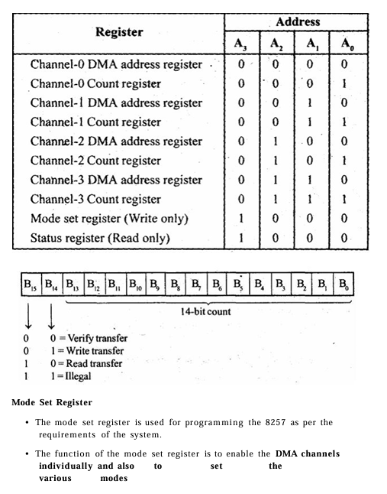
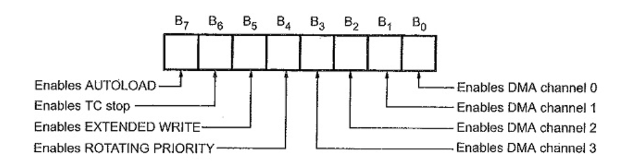
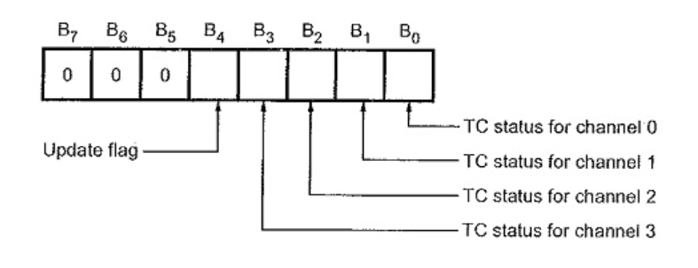
Intel 8257 – Pin Description
Mode Set Register
Status Register

